Slide 1
Module 2: Introduction to Git

Slide 2
Describe Git and its key features.
Compare Git with other SCMs.
Explain key concepts in Git.
Apply the steps to install Git.
Describe GitHub and creation of a repository.

Slide 3
Topic List
Introduction to Git
Key Concepts in Git
Installation
Introduction to Git Hub
Exercise 2.1: Install Git

Slide 4
Topic List
Introduction to Git
Key Concepts in Git
Installation
Introduction to Git Hub
Exercise 2.1: Install Git

Slide 5

Introduction to Git (1)
What is Git?
Git is free SCM software provided under the GNU general public license.
Each working directory of Git is a repository which includes the history with revision tracking thus maintaining versions.
It is independent of network/central server.
Editions can be done and saved without the same.

Slide 6

Introduction to Git (2)
What is Git?
Git – In Distributed Development
Each developer has a local copy of the development history.
Changes can be pushed or pulled from repository to repository copies.
Servers can be replicated and distributed around the world if necessary.
Performance tests shows that Git is much faster than other revision control systems.
With increase in historic data there is no hampering effect on the project.

Slide 7

Introduction to Git (2)
Key Features of Git
Following are the key features of Git:
Distributed Development
Strong Integrity
Non –Linear Development
Open Source
Scalable
Large Scale Projects

Slide 8
Introduction to Git (3)
Characteristics of Git
Following are the characteristics of Git:
Local Operation
Git operations are done on local resources and files.
Before storing, all files in Git are check-summed.
Files are referenced by checksum.
For check summing, Git uses SHA-1 hash mechanism.
Checksum is a string, generated based on the contents of a file or directory structure in Git.
It consists of 40 hexadecimal characters (0–9 and a–f). Example of SHA-1 hash: 24b9da6552252987aa493b52f8696cd6d3b00373.
Integrity
Git adds data
Git avoids data mess up for the changes that are yet to be committed unlike other VCS;
Once committed, a snapshot commits into Git.
Thus data can’t be lost, when there are frequent pushes of content into original or another repository.

Slide 9



Introduction to Git (4)
Git with Other Tools in Development Environment
Following figure represents the Git’s interactions with other tools:
gerrit
Code Store Repository
GIT’s main interaction is with Gerrit.
Code Review Interface for Store Repository
In turn integrates with Jenkins & Sonar.
Code Review Statistics
Build and Deployments
Git compliments the additional tools to form a fast, agile developer environment.

Slide 10
Introduction to Git (5)
Difference between Git and Other SCM
Following tables compares Git with other SCMs:
Git | Other SCM
Data is stored in the form of a stream of snapshots. | Stores data as a list of file based changes.
Takes a snapshot whenever a change is performed or saved. If there are no changes made, instead of taking snapshot and storing the file again, Git stores a reference to the previous identical file. | These systems (CVS, Subversion, Perforce, Bazaar, and so on) consider the information maintained as a set of files Tracks the changes made to each file over time.

Slide 11
Topic List
Introduction to Git
Key Concepts in Git
Installation
Introduction to Git Hub
Exercise 2.1: Install Git

Slide 12
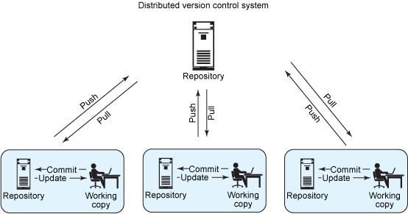
Key Concepts in Git (1)
Git Clone Principle
Every developer has a copy or clone of the central repository that contains a full copy of the repository including the history.
File changes and commits are performed locally.
Later, commits and changes are pushed to central repository.

Slide 13

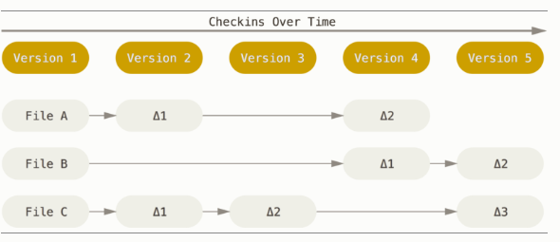
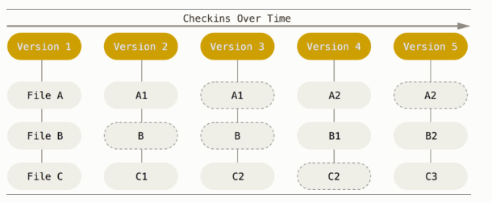
Key Concepts in Git (2)
Representation of Git Checkins
Following figure shows the representation of Git Checkins over time:

Slide 14
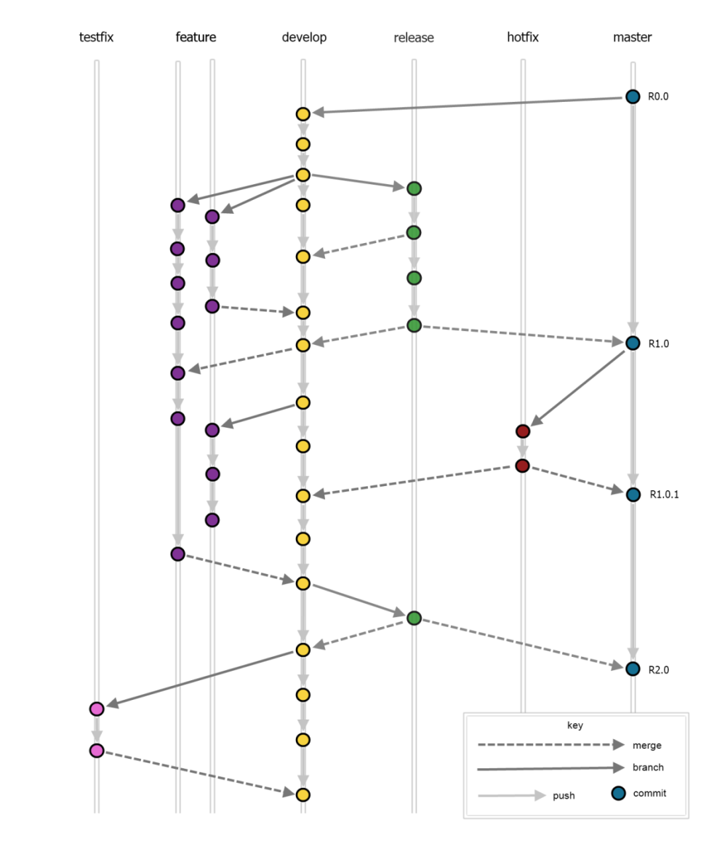
Key Concepts in Git (3)
Git Branching Technique
The branching model is based around the principle that there are two permanent branches in a repository and they are:
Develop: Captures all development work.
Master: Maintains the current live state (or at least live-ready releases).
Branching model also involves the use of temporary or support branches such as;
Feature
Release
Testfix
Hotfix
Each branch, merge or rebase in the overview can be performed with a single Git flow command.

Slide 15
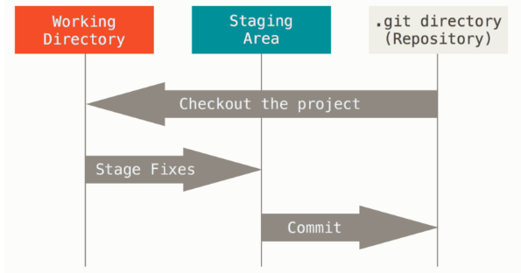
Key Concepts in Git (4)
Git Stages
Following are the different states in Git where the edited files can reside:
Committed
The data is saved and stored in the local database..
Modified
File(s) changed but not committed it to your database yet.
Staged
For the ones changes mark the changes and save it in staging so that it will go through the next a commit operation is performed.

Slide 16
Topic List
Introduction to Git
Key Concepts in Git
Installation
Introduction to Git Hub
Exercise 2.1: Install Git

Slide 17
Installation (1)
Installation Commands
Following table lists the commands to install Git in different operating systems:
Operating System | Command to Install
Linux | Run the following command: sudo yum install git-all
Debian-based like Ubuntu | Run the following command: sudo apt-get install git-all
Windows | Access the following link: http://git-scm.com/download/win The download will start automatically.

Slide 18
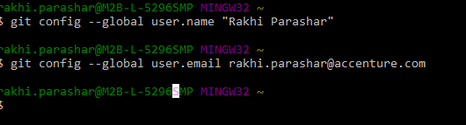
Installation (2)
Initial Configuration Setup
GIT_CONFIG is a tool in Git used to set configuration variables to control all operations of Git.
To set an identity, use the following commands:
git config --global user.name
git config --global user.email
Example
git config --global user.name “Rakhi Parashar"
git config --global user.email rakhi.parashar@accenture.com

Slide 19
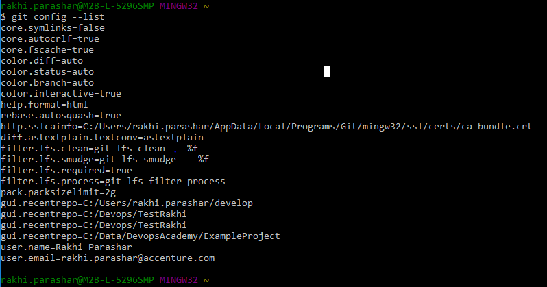
Installation (3)
Viewing Configurations
To view all the configurations use the following command:
git config –list
The configuration variables are stored in any of these three locations:
/etc/gitconfig file
~/.gitconfig or ~/.config/git/config file
config file in the Git directory (that is, .git/config)

Slide 20
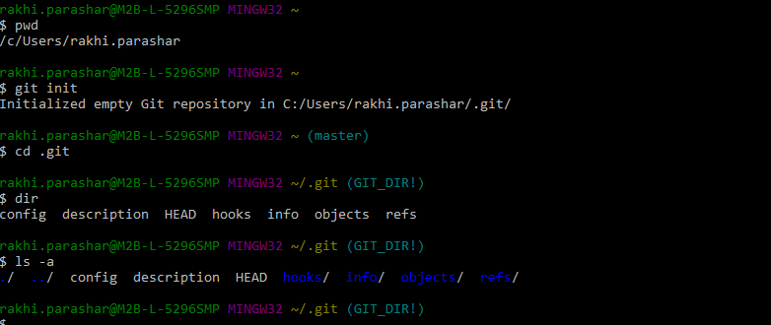
Installation (4)
Initializing Git Repository
When initializing a Git repository the system creates a ‘GIT’ directory in a new or in an existing project. To initialize Git repository execute the following command:
git init
Verifying the Git Repository Initialization
After executing the initialization command, you can verify it by performing the following:
Execute cd c:/<user>/.git/ to get into the Git directory.
Enter the command “dir” to list all files and directories.
The .git directory contains:
COMMIT_EDITMSG
Branches
config
description
gitweb
HEAD
Hooks
index
info/
Logs
Objects
ORIG_HEAD
packed-refs
refs

Slide 21
Topic List
Introduction to Git
Key Concepts in Git
Installation
Introduction to Git Hub
Exercise 2.1: Install Git

Slide 22

Introduction to GitHub (1)
Git Vs GitHub
Following table compares Git with GitHub:
Git | GITHub
Git is a command-line tool for effective operations.
Work and changes can locally be saved and eventually be committed and pushed to repositories created in Git Hub or elsewhere.
GITHub is a hosting service for Git repositories.
GITHub is a web-based Git repository hosting services. Apart from adding its own features, it offers all of the distributed version control and source code management functionality of Git.
Developers can store their projects in GitHub.com.
Also used to network with other Git users.

Slide 23

Introduction to GitHub (2)
Repository in GitHub
A repository is a location to store all the files for a particular project.
Apart from storing files, repository also stores history.
Repository is retrieved over a network where it acts as a server and version control tool acts as a client.
Clients can connect to the repository, and then they can store/retrieve their changes to/from repository.
Client saves the changes and makes it available to other people and other people’s changes are taken by the client as a working copy on his retrieval of changes.
Each project has its own repository, with a unique URL.

Slide 24
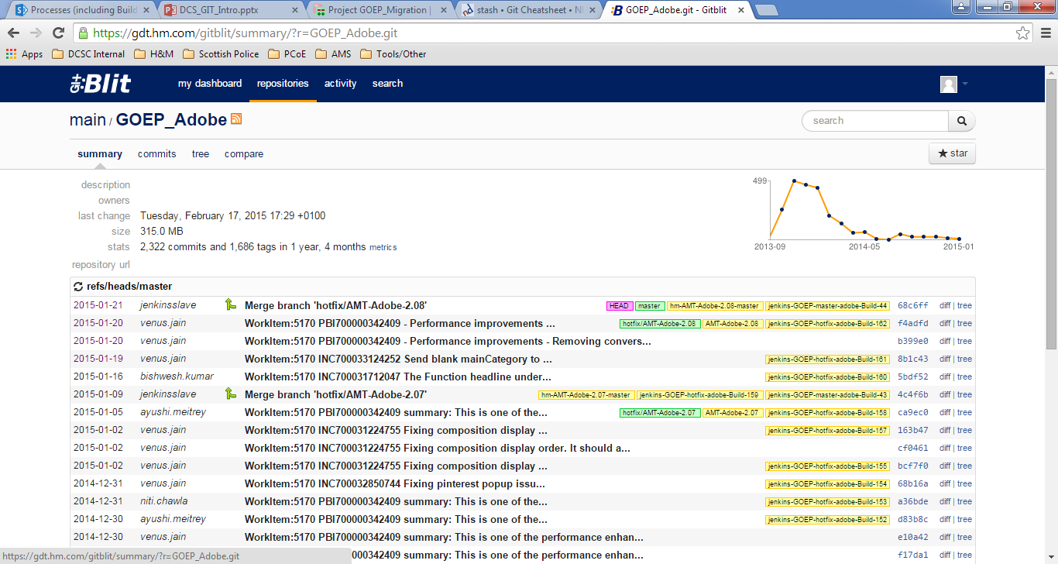
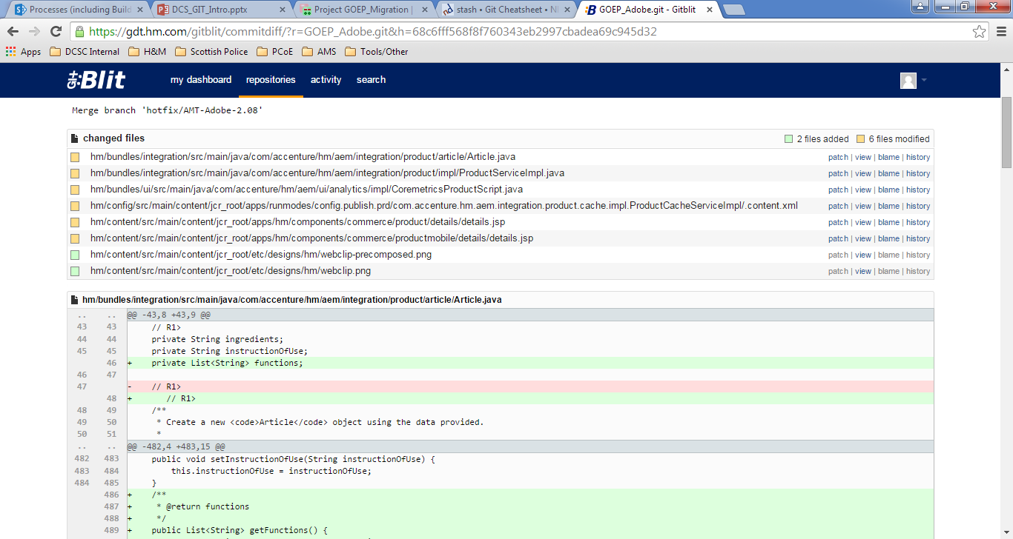
Introduction to GitHub (3)
Gitblit
Gitblit is the browser repository used in the project. Though it is used to display what appears on the remote repository, it is a visual history of the GIT repository.
Following screen capture shows the Gitblit repositories:

Slide 25
Topic List
Introduction to Git
Key Concepts in Git
Installation
Introduction to Git Hub
Exercise 2.1: Install Git

Slide 26
Exercise 2.1: Install Git
Scenario
To get started hands on for Git, we need to install GIT based on OS we use.
In this exercise, you need to practice the following tasks in your machine:
Install Git
Perform initial configuration setup
View configurations
Initializing Git repository

Slide 27

Knowledge Check
Select the right answer
Key features of GIT are:
Strong Integrity
Open Source
Code Review Statistics
Build and Deployments

Slide 28
Describe Git and its key features.
Compare Git with other SCMs.
Explain key concepts in Git.
Apply the steps to install Git.
Describe GitHub and creation of a repository.

Slide 29
https://help.github.com/articles/github-glossary/#commit
https://git-scm.com/book/en/Getting-Started-Git-Basics

Slide 30
Thank You

